Slide 1
Econ 210a
Master
Brad DeLong
U.C. Berkeley
Last Edited: 2020-04-29
<https://github.com/braddelong/public-files/blob/master/econ-210a-lectures-master.pptx>

Slide 2
Econ 210a
April 22, 2020 Class
Brad DeLong
U.C. Berkeley
Last Edited: 2020-04-08
<https://www.icloud.com/keynote/0Z2r-GEQD73BP9FRWMV6QA5bQ>
<https://github.com/braddelong/public-files/blob/master/econ-210a-lecture-12a.pptx>

Slide 3
Inequality
Brad DeLong
U.C. Berkeley
Last Edited: 2020-04-08

Slide 4
Readings
Inequality:
Branko Milanovic, Peter H. Lindert, & Jeffrey G. Williamson (2010): Pre-Industrial Inequality <https://github.com/braddelong/public-files/blob/master/readings/article-milanovic-%26-al-pre-industrial-inequality.pdf>
Thomas Piketty & Gabriel Zucman (2014): Capital Is Back: Wealth-Income Ratios in Rich Countries 1700–2010 <https://github.com/braddelong/public-files/blob/master/readings/article-piketty-zucman-capital-is-back.pdf>

Slide 5
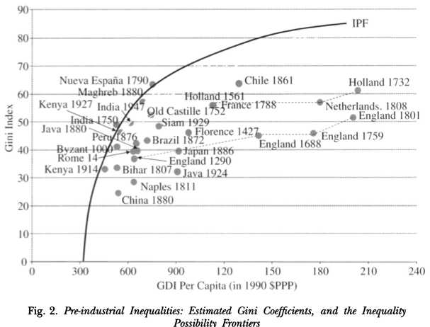
Milanovic & al.
Pre-Industrial Inequality:
<https://github.com/braddelong/public-files/blob/master/readings/article-milanovic-%26-al-pre-industrial-inequality.pdf>
“Is inequality largely the result of the Industrial Revolution? Or, were pre-industrial incomes as unequal as they are today? This article infers inequality across individuals within each of the 28 pre- industrial societies, for which data were available, using what are known as social tables. It applies two new concepts: the inequality possibility frontier and the inequality extraction ratio. They compare the observed income inequality to the maximum feasible inequality that, at a given level of income, might have been 'extracted' by those in power. The results give new insights into the connection between inequality and economic development in the very long run…”
Notes:
Normally in a market economy it is quite clear that voluntary exchanges are win-win, and very clear why they are win-win. One party is exchanging generalized purchasing power in the form of money for a commodity that has a substantial use value, a use value larger then what they could believe they could get at the margin from holding onto their money or spending it in alternative ways. The other party has a commodity that has a very low use value for them, and would rather have generalized purchasing power. When I buy coffee from Peets both of us are happy: I get caffeinated, and that is worth much more to me than the money I have to pay; they get money, and that is worth much more to them than the marginal cup of coffee they have made. If the Peets employees drank all the coffee they made in the day, they were die: coffee is poisonous in large doses.
Capital markets are different. In capital markets people are trading money—generalized puchasing power—for money. Where, then, is the win-win here? How do these markets fit into this standard template of supply-and-demand and of producer and consumer surplus that we use to understand markets and their benefits?

Slide 6
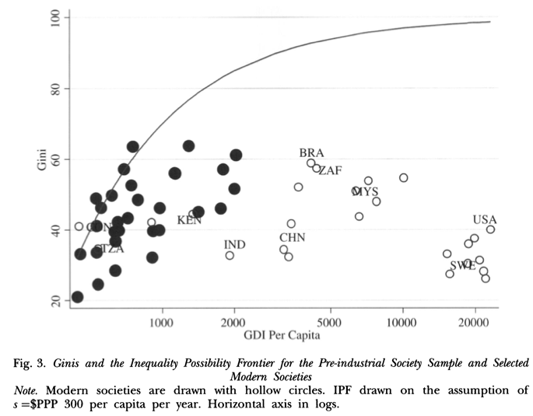
Into the Modern Age…
Notes:
Normally in a market economy it is quite clear that voluntary exchanges are win-win, and very clear why they are win-win. One party is exchanging generalized purchasing power in the form of money for a commodity that has a substantial use value, a use value larger then what they could believe they could get at the margin from holding onto their money or spending it in alternative ways. The other party has a commodity that has a very low use value for them, and would rather have generalized purchasing power. When I buy coffee from Peets both of us are happy: I get caffeinated, and that is worth much more to me than the money I have to pay; they get money, and that is worth much more to them than the marginal cup of coffee they have made. If the Peets employees drank all the coffee they made in the day, they were die: coffee is poisonous in large doses.
Capital markets are different. In capital markets people are trading money—generalized puchasing power—for money. Where, then, is the win-win here? How do these markets fit into this standard template of supply-and-demand and of producer and consumer surplus that we use to understand markets and their benefits?

Slide 7
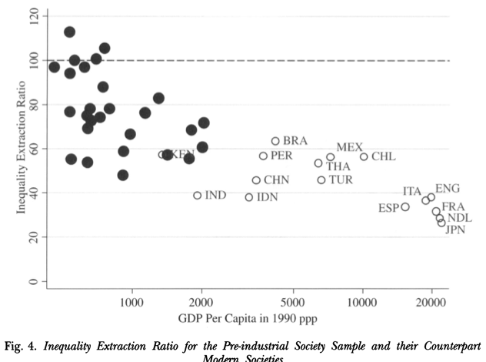
Inequality Extraction Ratios
Notes:
Normally in a market economy it is quite clear that voluntary exchanges are win-win, and very clear why they are win-win. One party is exchanging generalized purchasing power in the form of money for a commodity that has a substantial use value, a use value larger then what they could believe they could get at the margin from holding onto their money or spending it in alternative ways. The other party has a commodity that has a very low use value for them, and would rather have generalized purchasing power. When I buy coffee from Peets both of us are happy: I get caffeinated, and that is worth much more to me than the money I have to pay; they get money, and that is worth much more to them than the marginal cup of coffee they have made. If the Peets employees drank all the coffee they made in the day, they were die: coffee is poisonous in large doses.
Capital markets are different. In capital markets people are trading money—generalized puchasing power—for money. Where, then, is the win-win here? How do these markets fit into this standard template of supply-and-demand and of producer and consumer surplus that we use to understand markets and their benefits?

Slide 8
Thomas Piketty & Gabriel Zucman
Capital Is Back: Wealth-Income Ratios in Rich Countries 1700–2010:
<https://github.com/braddelong/public-files/blob/master/readings/article-piketty-zucman-capital-is-back.pdf>
“How do aggregate wealth-to-income ratios evolve in the long run and why? We address this question using 1970–2010 national balance sheets recently compiled in the top eight developed economies. For the United States, United Kingdom, Germany, and France, we are able to extend our analysis as far back as 1700. We find in every country a gradual rise‘ of wealth-income ratios in recent decades, from about 200–300% in 1970 to 400–600% in 2010. In effect, today’s ratios appear to be returning to the high values observed in Europe in the eighteenth and nineteenth centuries (600–700%). This can be explained by a long-run asset price recovery (itself driven by changes in capital policies since the world wars) and by the slowdown of productivity and population growth, in line with the 􏰀1⁄4 gs Harrod-Domar-Solow formula. That is, for a given net saving rate s1⁄410%, the long-run wealth-income ratio 􏰀 is about 300% if g1⁄43% and 600% if g1⁄41.5%. Our results have implications for capital taxation and regu- lation and shed new light on the changing nature of wealth, the shape of the production function, and the rise of capital shares…”
Notes:
Normally in a market economy it is quite clear that voluntary exchanges are win-win, and very clear why they are win-win. One party is exchanging generalized purchasing power in the form of money for a commodity that has a substantial use value, a use value larger then what they could believe they could get at the margin from holding onto their money or spending it in alternative ways. The other party has a commodity that has a very low use value for them, and would rather have generalized purchasing power. When I buy coffee from Peets both of us are happy: I get caffeinated, and that is worth much more to me than the money I have to pay; they get money, and that is worth much more to them than the marginal cup of coffee they have made. If the Peets employees drank all the coffee they made in the day, they were die: coffee is poisonous in large doses.
Capital markets are different. In capital markets people are trading money—generalized puchasing power—for money. Where, then, is the win-win here? How do these markets fit into this standard template of supply-and-demand and of producer and consumer surplus that we use to understand markets and their benefits?

Slide 9
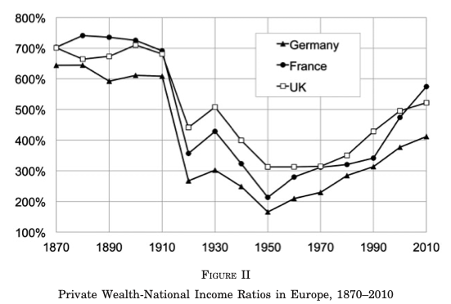
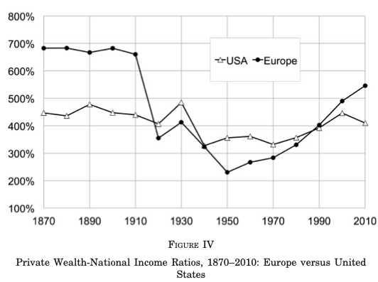
Since 1870 in the Global North
A common pattern in Europe:
Divergence with much smaller moves in the United States—so far
To what extent are these fluctuations in accumulated/improved productive asset stocks?
To what extent are these fluctuations in valuation ratios?
How are we to interpret fluctuations in valuation ratios?
Notes:
Normally in a market economy it is quite clear that voluntary exchanges are win-win, and very clear why they are win-win. One party is exchanging generalized purchasing power in the form of money for a commodity that has a substantial use value, a use value larger then what they could believe they could get at the margin from holding onto their money or spending it in alternative ways. The other party has a commodity that has a very low use value for them, and would rather have generalized purchasing power. When I buy coffee from Peets both of us are happy: I get caffeinated, and that is worth much more to me than the money I have to pay; they get money, and that is worth much more to them than the marginal cup of coffee they have made. If the Peets employees drank all the coffee they made in the day, they were die: coffee is poisonous in large doses.
Capital markets are different. In capital markets people are trading money—generalized puchasing power—for money. Where, then, is the win-win here? How do these markets fit into this standard template of supply-and-demand and of producer and consumer surplus that we use to understand markets and their benefits?

Slide 10
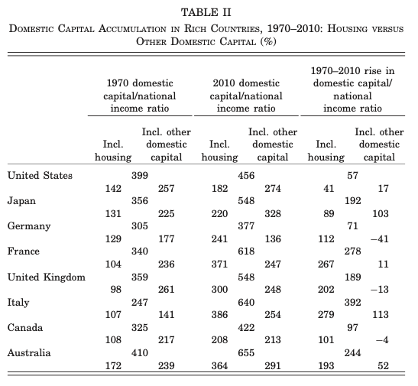
Housing vs. Other
How much of the rise in wealth/national income is housing?
And how much of the end-of-First-Gilded-Age-decline was the fall in value of agricultural land?
And how concentrated is housing/agricultural land relative to other forms of wealth?
Notes:
Normally in a market economy it is quite clear that voluntary exchanges are win-win, and very clear why they are win-win. One party is exchanging generalized purchasing power in the form of money for a commodity that has a substantial use value, a use value larger then what they could believe they could get at the margin from holding onto their money or spending it in alternative ways. The other party has a commodity that has a very low use value for them, and would rather have generalized purchasing power. When I buy coffee from Peets both of us are happy: I get caffeinated, and that is worth much more to me than the money I have to pay; they get money, and that is worth much more to them than the marginal cup of coffee they have made. If the Peets employees drank all the coffee they made in the day, they were die: coffee is poisonous in large doses.
Capital markets are different. In capital markets people are trading money—generalized puchasing power—for money. Where, then, is the win-win here? How do these markets fit into this standard template of supply-and-demand and of producer and consumer surplus that we use to understand markets and their benefits?

Slide 11
Great Depression:
Recovery
Brad DeLong
U.C. Berkeley
Last Edited: 2020-04-08

Slide 12
Readings
The Great Depression: Recovery:
Christina Romer (1992): What Ended the Great Depression? <http://www.jstor.org/stable/2123226>
Gauti Eggertsson (2008): Great Expectations and the End of the Great Depression <http://www.jstor.org/stable/29730131>
Joshua Hausman (2016): Fiscal Policy and Economic Recovery: The Case of the 1936 Veterans’ Bonus <https://www.aeaweb.org/articles?id=10.1257/aer.20130957>

Slide 13
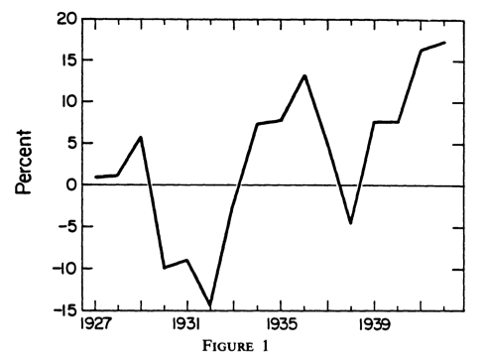
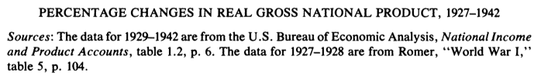
Romer: What Ended the Great Depression?
<http://www.jstor.org/stable/2123226>:
Between 1933 and 1937 real GNP in the United States grew at an average rate of over 8 percent per year
Between 1938 and, 1941 it grew over 10 percent per year
Notes:
Normally in a market economy it is quite clear that voluntary exchanges are win-win, and very clear why they are win-win. One party is exchanging generalized purchasing power in the form of money for a commodity that has a substantial use value, a use value larger then what they could believe they could get at the margin from holding onto their money or spending it in alternative ways. The other party has a commodity that has a very low use value for them, and would rather have generalized purchasing power. When I buy coffee from Peets both of us are happy: I get caffeinated, and that is worth much more to me than the money I have to pay; they get money, and that is worth much more to them than the marginal cup of coffee they have made. If the Peets employees drank all the coffee they made in the day, they were die: coffee is poisonous in large doses.
Capital markets are different. In capital markets people are trading money—generalized puchasing power—for money. Where, then, is the win-win here? How do these markets fit into this standard template of supply-and-demand and of producer and consumer surplus that we use to understand markets and their benefits?

Slide 14
Romer: What Ended the Great Depression? II
<http://www.jstor.org/stable/2123226>:
This paper examines the role of aggregate-demand stimulus in ending the Great Depression. Plausible estimates of the effects of fiscal and monetary changes indicate that nearly all the observed recovery of the U.S. economy prior to 1942 was due to monetary expansion. A huge gold inflow in the mid- and late 1930s swelled the money stock and stimulated the economy by lowering real interest rates and encouraging investment spending and purchases of durable goods. That monetary developments were crucial to the recovery implies that self-correction played little role in the growth of real output between 1933 and 1942…
Notes:
Normally in a market economy it is quite clear that voluntary exchanges are win-win, and very clear why they are win-win. One party is exchanging generalized purchasing power in the form of money for a commodity that has a substantial use value, a use value larger then what they could believe they could get at the margin from holding onto their money or spending it in alternative ways. The other party has a commodity that has a very low use value for them, and would rather have generalized purchasing power. When I buy coffee from Peets both of us are happy: I get caffeinated, and that is worth much more to me than the money I have to pay; they get money, and that is worth much more to them than the marginal cup of coffee they have made. If the Peets employees drank all the coffee they made in the day, they were die: coffee is poisonous in large doses.
Capital markets are different. In capital markets people are trading money—generalized puchasing power—for money. Where, then, is the win-win here? How do these markets fit into this standard template of supply-and-demand and of producer and consumer surplus that we use to understand markets and their benefits?

Slide 15
Assume a Monetarist Model
Use policy multipliers based on the experience of 1921 and 1938:
βm = 0.823 %-point to %-point
βf = -0.233 %-point to %-point
Real GNP would have been approximately 25 percent lower in 1937 if the money supply had continued to grow at its historical average rate
Real GNP would have been nearly 50 percent lower in 1942 than it actually was if the money supply had continued to grow at its historical average rate
Changes in the government budget surplus played little role in generating the recovery
But what is the counterfactual here?
Notes:
Normally in a market economy it is quite clear that voluntary exchanges are win-win, and very clear why they are win-win. One party is exchanging generalized purchasing power in the form of money for a commodity that has a substantial use value, a use value larger then what they could believe they could get at the margin from holding onto their money or spending it in alternative ways. The other party has a commodity that has a very low use value for them, and would rather have generalized purchasing power. When I buy coffee from Peets both of us are happy: I get caffeinated, and that is worth much more to me than the money I have to pay; they get money, and that is worth much more to them than the marginal cup of coffee they have made. If the Peets employees drank all the coffee they made in the day, they were die: coffee is poisonous in large doses.
Capital markets are different. In capital markets people are trading money—generalized puchasing power—for money. Where, then, is the win-win here? How do these markets fit into this standard template of supply-and-demand and of producer and consumer surplus that we use to understand markets and their benefits?

Slide 16
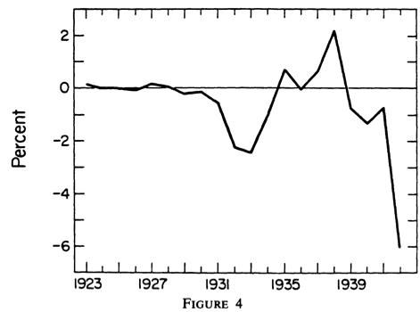
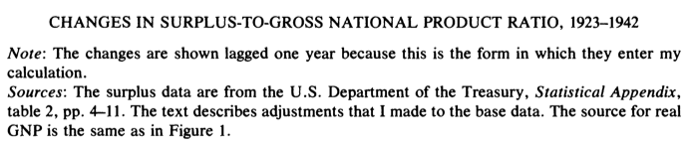
Why Doesn’t Fiscal Policy Matter?
Because the Roosevelt administration did not raise the deficit (much):
Hence you multiply a small number by 0.23, and get a small number
But what if the government had strained every nerve to balance the budget, instead of letting the deficit roll at its 1933 share of national income?
Notes:
Normally in a market economy it is quite clear that voluntary exchanges are win-win, and very clear why they are win-win. One party is exchanging generalized purchasing power in the form of money for a commodity that has a substantial use value, a use value larger then what they could believe they could get at the margin from holding onto their money or spending it in alternative ways. The other party has a commodity that has a very low use value for them, and would rather have generalized purchasing power. When I buy coffee from Peets both of us are happy: I get caffeinated, and that is worth much more to me than the money I have to pay; they get money, and that is worth much more to them than the marginal cup of coffee they have made. If the Peets employees drank all the coffee they made in the day, they were die: coffee is poisonous in large doses.
Capital markets are different. In capital markets people are trading money—generalized puchasing power—for money. Where, then, is the win-win here? How do these markets fit into this standard template of supply-and-demand and of producer and consumer surplus that we use to understand markets and their benefits?

Slide 17
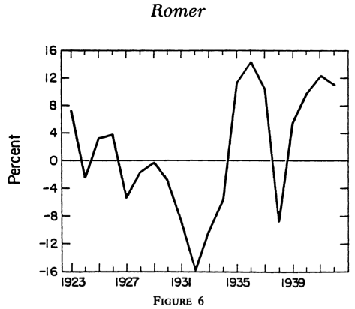
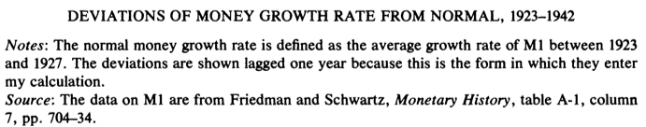
Why Does Monetary Policy Matter?
Because the money stock bounced back after 1933:
And the calibration assumes that changes in the money stock cause big changes in nominal spending
Even if interest rates are at or near there zero lower bound
This is something that we believe in much much much less strongly than we believed in it back in 1992
Notes:
Normally in a market economy it is quite clear that voluntary exchanges are win-win, and very clear why they are win-win. One party is exchanging generalized purchasing power in the form of money for a commodity that has a substantial use value, a use value larger then what they could believe they could get at the margin from holding onto their money or spending it in alternative ways. The other party has a commodity that has a very low use value for them, and would rather have generalized purchasing power. When I buy coffee from Peets both of us are happy: I get caffeinated, and that is worth much more to me than the money I have to pay; they get money, and that is worth much more to them than the marginal cup of coffee they have made. If the Peets employees drank all the coffee they made in the day, they were die: coffee is poisonous in large doses.
Capital markets are different. In capital markets people are trading money—generalized puchasing power—for money. Where, then, is the win-win here? How do these markets fit into this standard template of supply-and-demand and of producer and consumer surplus that we use to understand markets and their benefits?

Slide 18
Gold & the Money Supply
Gold inflows then expanded the month stock:
A gold inflow due to devaluation in 1933
A gold inflow to capital flight from Europe because of political instability after 1934
Coincident with this gold inflow, real interest rates fell precipitously in 1933
Real interest rates remained low or negative throughout most of the second half of the 1930s
A strong rebound in interest-sensitive spending
Notes:
Normally in a market economy it is quite clear that voluntary exchanges are win-win, and very clear why they are win-win. One party is exchanging generalized purchasing power in the form of money for a commodity that has a substantial use value, a use value larger then what they could believe they could get at the margin from holding onto their money or spending it in alternative ways. The other party has a commodity that has a very low use value for them, and would rather have generalized purchasing power. When I buy coffee from Peets both of us are happy: I get caffeinated, and that is worth much more to me than the money I have to pay; they get money, and that is worth much more to them than the marginal cup of coffee they have made. If the Peets employees drank all the coffee they made in the day, they were die: coffee is poisonous in large doses.
Capital markets are different. In capital markets people are trading money—generalized puchasing power—for money. Where, then, is the win-win here? How do these markets fit into this standard template of supply-and-demand and of producer and consumer surplus that we use to understand markets and their benefits?

Slide 19
What Determines the Money Supply?
The monetary base and the money multiplier:
Money multiplier components:
D/R: 8.86 -> 4.67
D/C: little action until WWII imminent
Would the D/R ratio have fallen much less if there had been much less of a gold-reserve inflow?
Maybe…
Notes:
Normally in a market economy it is quite clear that voluntary exchanges are win-win, and very clear why they are win-win. One party is exchanging generalized purchasing power in the form of money for a commodity that has a substantial use value, a use value larger then what they could believe they could get at the margin from holding onto their money or spending it in alternative ways. The other party has a commodity that has a very low use value for them, and would rather have generalized purchasing power. When I buy coffee from Peets both of us are happy: I get caffeinated, and that is worth much more to me than the money I have to pay; they get money, and that is worth much more to them than the marginal cup of coffee they have made. If the Peets employees drank all the coffee they made in the day, they were die: coffee is poisonous in large doses.
Capital markets are different. In capital markets people are trading money—generalized puchasing power—for money. Where, then, is the win-win here? How do these markets fit into this standard template of supply-and-demand and of producer and consumer surplus that we use to understand markets and their benefits?

Slide 20
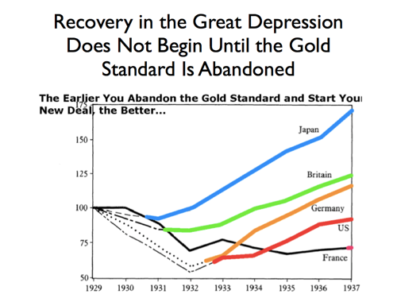
Regime Change and Policy
The devaluation of 1933:
Replaced a deflationary monetary-contraction regime by an inflationary monetary expansion regime
The cross-country pattern is, once again, convincing…
Notes:
Normally in a market economy it is quite clear that voluntary exchanges are win-win, and very clear why they are win-win. One party is exchanging generalized purchasing power in the form of money for a commodity that has a substantial use value, a use value larger then what they could believe they could get at the margin from holding onto their money or spending it in alternative ways. The other party has a commodity that has a very low use value for them, and would rather have generalized purchasing power. When I buy coffee from Peets both of us are happy: I get caffeinated, and that is worth much more to me than the money I have to pay; they get money, and that is worth much more to them than the marginal cup of coffee they have made. If the Peets employees drank all the coffee they made in the day, they were die: coffee is poisonous in large doses.
Capital markets are different. In capital markets people are trading money—generalized puchasing power—for money. Where, then, is the win-win here? How do these markets fit into this standard template of supply-and-demand and of producer and consumer surplus that we use to understand markets and their benefits?

Slide 21
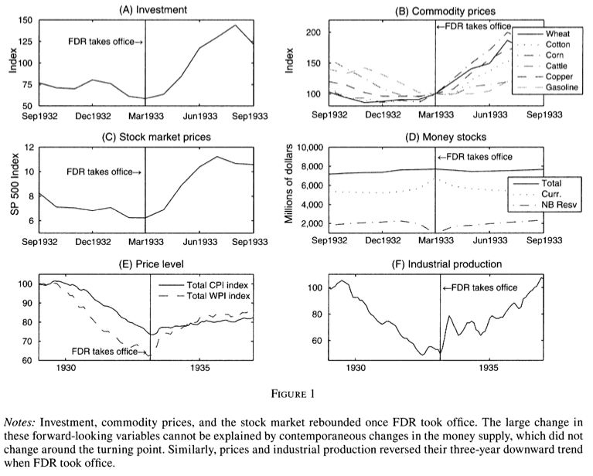
Eggertsson: Great Expectations and the End of the Great Depression
<http://www.jstor.org/stable/29730131>:
It is hard to overstate how radical the regime change was.
"This is the end of Western civilization," declared Director of the Budget Lewis Douglas.
During Roosevelt's first year in office, Douglas and Acting Treasury Secretary Dean Acheson resigned in protest…
Despite the fact that neither the nominal interest rate nor the money supply changed… the elimination of the policy dogmas drastically changed the systematic part of monetary policy…
Notes:
Normally in a market economy it is quite clear that voluntary exchanges are win-win, and very clear why they are win-win. One party is exchanging generalized purchasing power in the form of money for a commodity that has a substantial use value, a use value larger then what they could believe they could get at the margin from holding onto their money or spending it in alternative ways. The other party has a commodity that has a very low use value for them, and would rather have generalized purchasing power. When I buy coffee from Peets both of us are happy: I get caffeinated, and that is worth much more to me than the money I have to pay; they get money, and that is worth much more to them than the marginal cup of coffee they have made. If the Peets employees drank all the coffee they made in the day, they were die: coffee is poisonous in large doses.
Capital markets are different. In capital markets people are trading money—generalized puchasing power—for money. Where, then, is the win-win here? How do these markets fit into this standard template of supply-and-demand and of producer and consumer surplus that we use to understand markets and their benefits?

Slide 22
Eggertson: Great Expectations II
<http://www.jstor.org/stable/29730131>:
This paper suggests that the US recovery from the Great Depression was driven by a shift in expectations. This shift was caused by President Franklin Delano Roosevelt’s policy actions. On the monetary policy side, Roosevelt abolished the gold standard and?even more importantly?announced the explicit objective of inflating the price level to pre-Depression levels. On the fiscal policy side, Roosevelt expanded real and deficit spending, which made his policy objective credible. These actions violated prevailing policy dogmas and initiated a policy regime change as in Sargent (1983) and Temin and Wigmore (1990). The economic consequences of Roosevelt are evaluated in a dynamic stochastic general equilibrium model with nominal frictions…
Notes:
Normally in a market economy it is quite clear that voluntary exchanges are win-win, and very clear why they are win-win. One party is exchanging generalized purchasing power in the form of money for a commodity that has a substantial use value, a use value larger then what they could believe they could get at the margin from holding onto their money or spending it in alternative ways. The other party has a commodity that has a very low use value for them, and would rather have generalized purchasing power. When I buy coffee from Peets both of us are happy: I get caffeinated, and that is worth much more to me than the money I have to pay; they get money, and that is worth much more to them than the marginal cup of coffee they have made. If the Peets employees drank all the coffee they made in the day, they were die: coffee is poisonous in large doses.
Capital markets are different. In capital markets people are trading money—generalized puchasing power—for money. Where, then, is the win-win here? How do these markets fit into this standard template of supply-and-demand and of producer and consumer surplus that we use to understand markets and their benefits?

Slide 23
How Does Money Affect Output?
The mechanical quantity theory:
Money burns a hole in your pocket and drops out, thus being spent on currently-produced goods and services
The mechanical quantity theory is not in good odor today:
Instead, it has to work through interest rates
Present and future interest rates
Which means that monetary expansion at the ZLB today has effects only to the extent that it raises the expected money stock at some point in the future at which the economy is expected to be no longer at the ZLB
Hence the money stock has to be “sticky” in some sense…
Krugman: credibly promise not to be responsible…
Notes:
Normally in a market economy it is quite clear that voluntary exchanges are win-win, and very clear why they are win-win. One party is exchanging generalized purchasing power in the form of money for a commodity that has a substantial use value, a use value larger then what they could believe they could get at the margin from holding onto their money or spending it in alternative ways. The other party has a commodity that has a very low use value for them, and would rather have generalized purchasing power. When I buy coffee from Peets both of us are happy: I get caffeinated, and that is worth much more to me than the money I have to pay; they get money, and that is worth much more to them than the marginal cup of coffee they have made. If the Peets employees drank all the coffee they made in the day, they were die: coffee is poisonous in large doses.
Capital markets are different. In capital markets people are trading money—generalized puchasing power—for money. Where, then, is the win-win here? How do these markets fit into this standard template of supply-and-demand and of producer and consumer surplus that we use to understand markets and their benefits?

Slide 24
Moving to a NK DSGE Model…
I still do not understand the attraction:
The point is to get an “IS curve”: real spending on currently-produced goods and services as a downward-sloping function of the expected real interest rate
The point is to get a “Phillips curve”: a relationship of price-level changes to expectations and to the level of spending
And to allow policy to show itself through the choice of the interest rate by the central bank
Notes:
Normally in a market economy it is quite clear that voluntary exchanges are win-win, and very clear why they are win-win. One party is exchanging generalized purchasing power in the form of money for a commodity that has a substantial use value, a use value larger then what they could believe they could get at the margin from holding onto their money or spending it in alternative ways. The other party has a commodity that has a very low use value for them, and would rather have generalized purchasing power. When I buy coffee from Peets both of us are happy: I get caffeinated, and that is worth much more to me than the money I have to pay; they get money, and that is worth much more to them than the marginal cup of coffee they have made. If the Peets employees drank all the coffee they made in the day, they were die: coffee is poisonous in large doses.
Capital markets are different. In capital markets people are trading money—generalized puchasing power—for money. Where, then, is the win-win here? How do these markets fit into this standard template of supply-and-demand and of producer and consumer surplus that we use to understand markets and their benefits?

Slide 25
Hoover Policy Dogmas
Eggertson sees three:
The perceived need for small government to foster a recovery: Hoover’s claim that "every additional" government expenditure would cause "intolerable pressures”
Hoover's second dogma was to balance the budget.
Eggertson: “The most important aspect of the Roosevelt regime change is that it implies a commitment to lower future nominal interest rates relative to the Hoover regime, a higher future price level, and hence a permanent increase in the money supply…”
Notes:
Normally in a market economy it is quite clear that voluntary exchanges are win-win, and very clear why they are win-win. One party is exchanging generalized purchasing power in the form of money for a commodity that has a substantial use value, a use value larger then what they could believe they could get at the margin from holding onto their money or spending it in alternative ways. The other party has a commodity that has a very low use value for them, and would rather have generalized purchasing power. When I buy coffee from Peets both of us are happy: I get caffeinated, and that is worth much more to me than the money I have to pay; they get money, and that is worth much more to them than the marginal cup of coffee they have made. If the Peets employees drank all the coffee they made in the day, they were die: coffee is poisonous in large doses.
Capital markets are different. In capital markets people are trading money—generalized puchasing power—for money. Where, then, is the win-win here? How do these markets fit into this standard template of supply-and-demand and of producer and consumer surplus that we use to understand markets and their benefits?

Slide 26
Econ 210a
April 29, 2020 Class
Brad DeLong
U.C. Berkeley
Last Edited: 2020-04-08
<https://www.icloud.com/keynote/0Z2r-GEQD73BP9FRWMV6QA5bQ>
<https://github.com/braddelong/public-files/blob/master/econ-210a-lecture-12a.pptx>

Slide 27
Race, the American South, & the American North
Brad DeLong
U.C. Berkeley
Last Edited: 2020-04-13

Slide 28
Readings
Race, the American South, & the American North:
Gavin Wright (1987): The Economic Revolution in the American South <https://www.aeaweb.org/articles?id=10.1257jep.1.1.161>
Taylor Jaworski (2017): World War II and the Industrialization of the American South <http://www.nber.org/papers/w23477>
Ellora Derenocourt (2018): Can You Move to Opportunity? Evidence from the Great Migration <https://scholar.harvard.edu/elloraderenoncourt/publications>

Slide 29
Convergence & Its Absence
Brad DeLong
U.C. Berkeley
Last Edited: 2020-04-13

Slide 30
Readings
Convergence & Its Absence
Lant Pritchett (1997): Divergence, Big Time <http://tinyurl.com/dl20090112o>
Dev Patel, Justin Sandefur, & Arvind Subramanian (2018): Everything You Know about Cross-Country Convergence Is (Now) Wrong <https://www.piie.com/blogs/realtime-economic-issues-watch/everything-you-know-about-cross-country-convergence-now-wrong>
Paul Johnson & Chris Papageorgiou: What Remains of Cross-Country Convergence? <https://delong.typepad.com/files/johnson-papageorgiou.pdf>

Slide 31
Lant Pritchett (1997): Divergence, Big Time
Questions:
What is your reasonable lower bound as to what national income per capita could have been in any country in 1870 or before? How did you arrive at this lower bound?
What distinguishes the countries that have converged to relative (and absolute!) wealth since 1870?
What common factors do the “other” countries that have not converged to relative wealth since 1870 share?
What was the ratio of the national income of the richest to the poorest country in 1870?
What was the ratio of the national income of the richest to the poorest country in 1990?
What is the role of international price structures in relative income comparisons?
<http://tinyurl.com/dl20090112o>

Slide 32
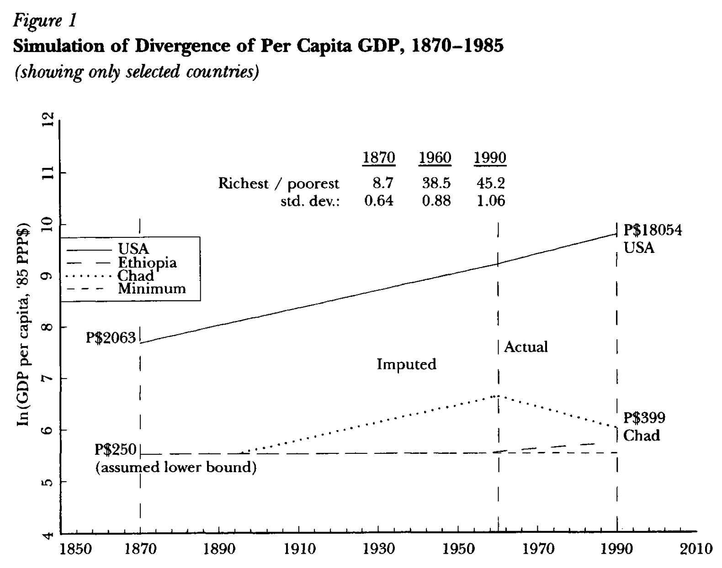
The Necessity of Divergence
Place a reasonable lower bound on what GDP per capita could have been in 1870 in any country:
Using the purchasing power adjustments for exchange rates has an especially important effect in poor countries…
Tradable goods will have generally the same prices across countries because of arbitrage…
Nontradable goods are typically much cheaper in poorer countries because of their lower income levels
A country with a per capita GDP level of $70 (1997) in U.S. dollars, measured in market exchange rates, will have a per capita GDP of P$250 (1997)…
The lowest five-year average level of per capita GDP reported for any country in the Penn World Tables (Mark 5) is P$275 (1997) for Ethiopia in 1961–65…
Maddison (1991) gives estimates of GDP per capita of some less developed countries as early as 1820: P$531 (1997) for India, P$523 (1997) for China and P$614 (1997) for Indonesia. His earliest estimates for Africa begin in 1913: P$508 (1997) for Egypt and P$648 (1997) for Ghana
If you accept: a) the current estimates of relative incomes across nations; b) the estimates of the historical growth rates of the now-rich nations; and c) that even in the poorest economies incomes were not below P$250 (1997) at any point—then you cannot escape the conclusion that the last 150 years have seen divergence, big time…

Slide 33
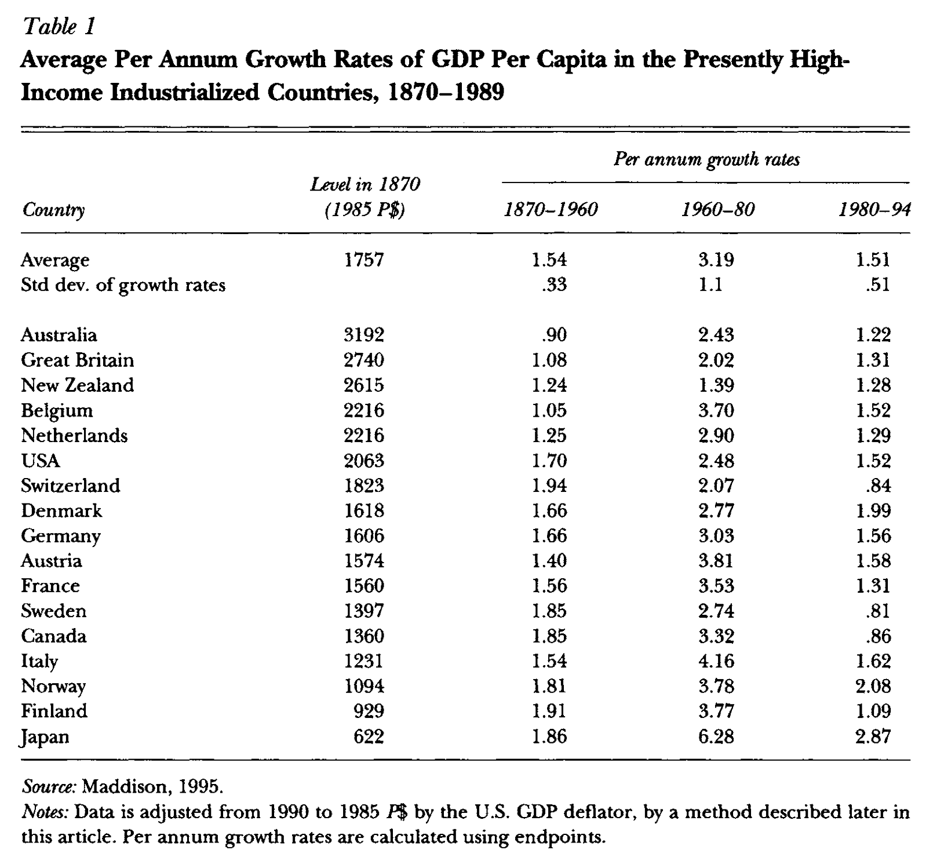
Pritchett Divides the World into Two
Two sets of countries: one clear:
The "developed" or the "advanced capitalist”… or the "high income OECD" … European countries and their offshoots plus Japan.
Since 1870, the long-run growth rates of these countries have been:
rapid (by previous historical standards)…
remarkably similar
the poorer members… grew sufficiently faster to produce considerable convergence…
Sample selection problems here?

Slide 34
The Global North “Developed” Economies
There is strong convergence in per capita incomes within this set of countries…
The narrow range of the growth rates over the 1870-1960 period is striking. The United States, the richest country in 1960, had grown at 1.7 percent per annum since 1870, while the overall average was 1.54. Only one country, Australia, grew either a half a percentage point higher or lower than the average, and the standard deviation of the growth rates was only 0.33…
At least since 1870 there has been no obvious acceleration of overall growth rates over time…
Jones (1995) uses this basic fact of the constancy of growth to good effect in creating a compelling argument that the steadiness of U.S. growth implies that endogenous growth models that make growth a function of nonstationary variables, such as the level of R&D spending or the level of education of the labor force, are likely incorrect: they imply an accelerating growth rate (unless several variables working in opposite directions just happen to offset each other)...

Slide 35
Pritchett on the Global South
Two sets of countries: The second:
The other… awkwardly, defined only as "the other set of countries," as they have nothing else in common…
[Experiences have] been strikingly different… with some converging rapidly on the leaders while others stagnate; and over time, with a mixed record of takeoffs, stalls and nose dives…
From 1870 to 1990 the ratio of per capita incomes between the richest and the poorest countries increased by roughly a factor of five…

Slide 36
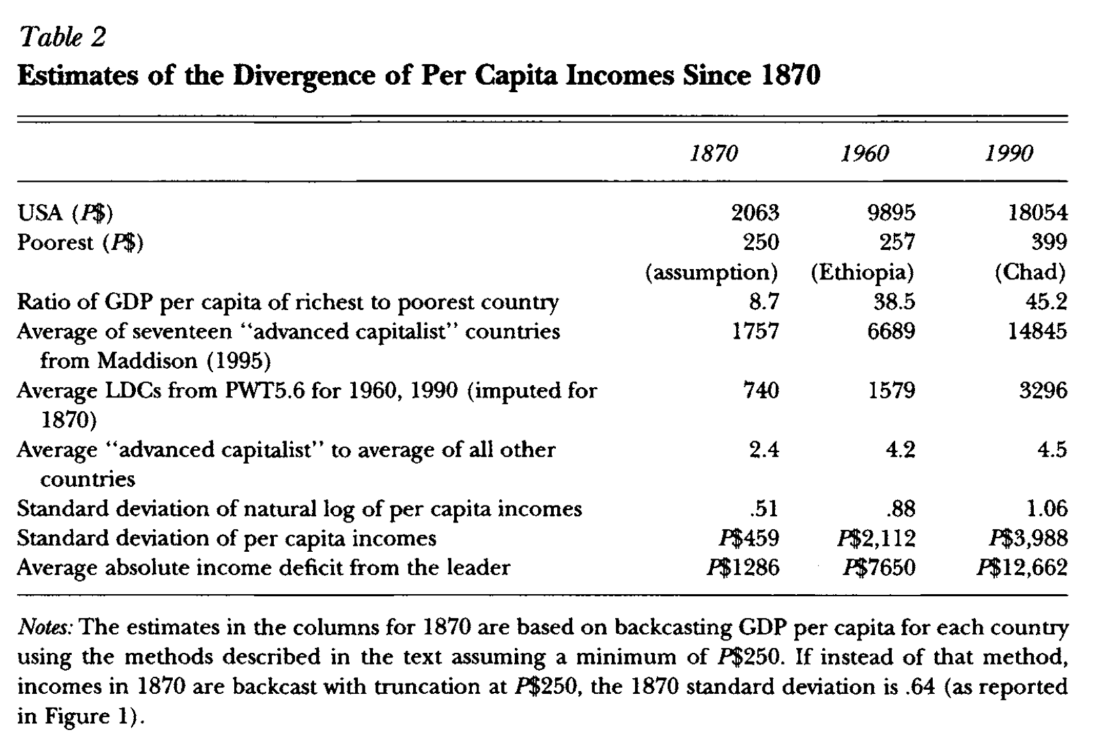
Estimates of Divergence

Slide 37
The “Other” Economies
Poverty Traps, Takeoffs and Convergence:
Sixteen developing countries had negative growth over the 1960–1990 period, including Mozambique ( 2.2 percent per annum) and Guyana ( .7 percent per annum) …
As Ben-David and Papell (1995) emphasize, many developing countries have seen their economies go into not just a slowdown, but a “meltdown”…
If we calculate the growth rates in the Penn World Tables and allow the data to dictate one break in the growth rate over the whole 1960–1990 period, then of the 103 developing countries, 81 have seen a deceleration of growth over the period, and the average deceleration is over 3 percentage points…
From 1980–1994, growth in per capita GDP averaged 1.5 percent in the advanced countries and .34 percent in the less developed countries…
These facts about growth in less developed countries highlight its enormous vari- ability and volatility. The range of annual growth rates in per capita GDP across less developed economies from 1960 to 1990 is from 2.7 percent to positive 6.9 percent…

Slide 38
Further Reading
Dan Ben-David and David Papell (1995): Slowdowns and Meltdowns: Post-War Growth Evidence from 74 Countries
Charles Jones (1995): R&D-Based Models of Economic Growth <https://delong.typepad.com/files/jones-r--d.pdf>
Fabio Canova and Albert Marcet (1995): The Poor Stay Poor: Non-Convergence Across Countries and Regions
J. Bradford DeLong (1988): Productivity Growth, Convergence, and Welfare: Comment
William Easterly, Michael Kremer, Lant Pritchett, and Lawrence Summers (1993): Good Policy or Good Luck? Country Growth Performance and Temporary Shocks
Alexander Gerschenkron (1962): Economic Backwardness in Historical Perspective, a Book of Essays
John R. Hanson (1988): Third World Incomes before World War I: Some Comparisons
John R. Hanson (1991): Third World Incomes before World War I: Further Evidence
Charles Jones (1995): R&D Based Models of Economic Growth
N. Gregory Mankiw, David Romer, and David Weil (1992): A Contribution to the Empirics of Economic Growth

Slide 39
Catch Our Breath…
Ask a couple of questions?
Make a couple of comments?
Any more readings to recommend?

Slide 40
Paul Johnson & Chris Papageorgiou: What Remains of Cross-Country Convergence?
Questions:
Do the regions as Johnson and Papageorgiou define them make sense?
Do the stratifications as JP define them make sense?
Are there historical factors and episodes that we can use to understand the MIC trap that they fell in in the 1980s and 1990s?
And why did this MIC trap come, apparently, to an end when the millennium came?
Is there a definition of “fragile” LICs other than that people have decided to fight wars in them, and that they have done badly in terms of growth?
Why should being “fragile” not matter until the 1990s?
Should we compare MICs and LICs to a HIC growth benchmark? Or is whatever is happening to the HICs in a particular decade substantially irrelevant to MIC and LIC expectations?
<https://delong.typepad.com/files/johnson-papageorgiou.pdf>

Slide 41
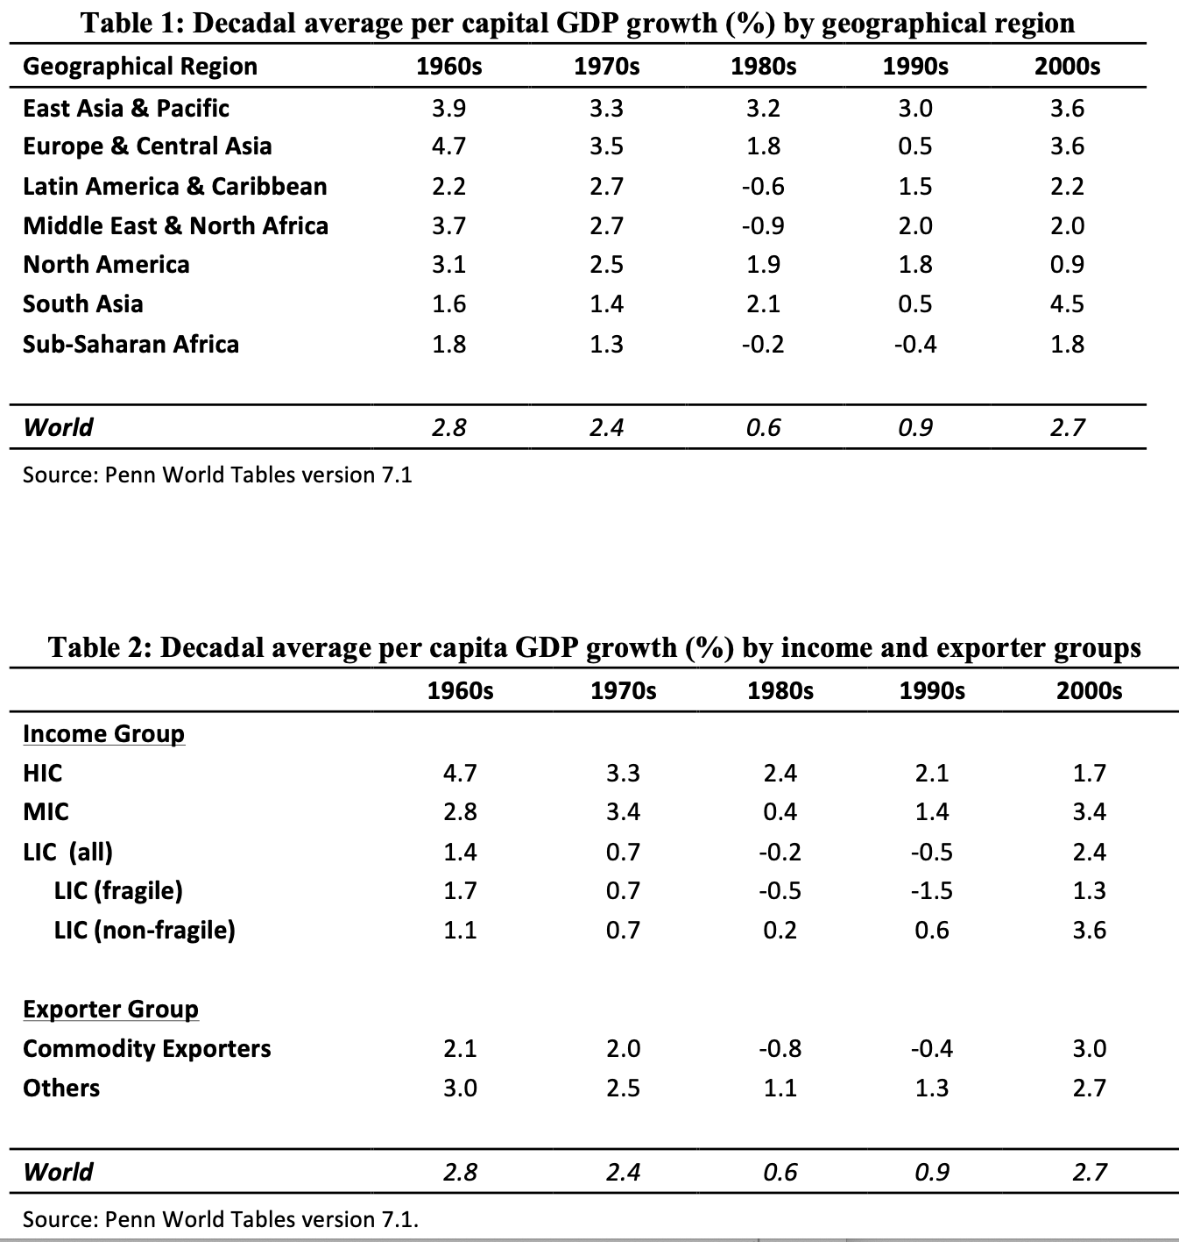
No Convergence since 1965
Abstract:
We examine the record of cross-country growth over the past 50 years and ask if developing countries have made progress on closing income gap between their per capita incomes and those in the advanced economies.
We conclude that, as a group, they have not and then survey the literature on absolute convergence with particular emphasis on that from the last decade or so. That literature supports our conclusion of a lack of progress in closing the income gap between countries.
We close with a brief examination of the recent literature on cross-individual distribution of income which finds that, despite the lack of progress on cross country convergence, global inequality has tended to fall since 2000.
Wait a minute? How has global equality been falling since 2000?

Slide 42
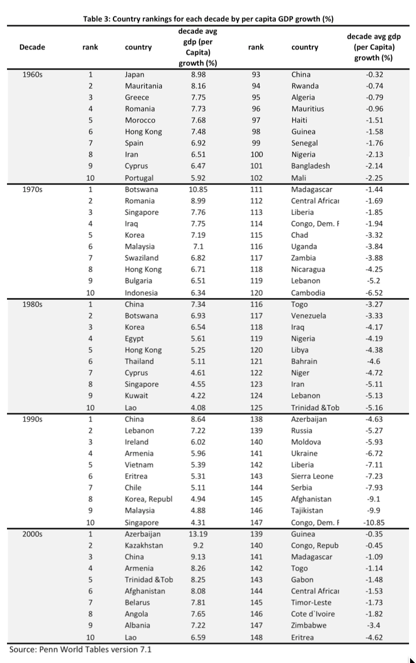
Top Performers
Is there a pattern in “top performers” & “bottom performers”:
Not really…
Some bounce-backs
Some drives to global north status
“Convergence clubs”?
Countries with similar cultures/institutions
What convergence clubs would one have selected ex ante?

Slide 43
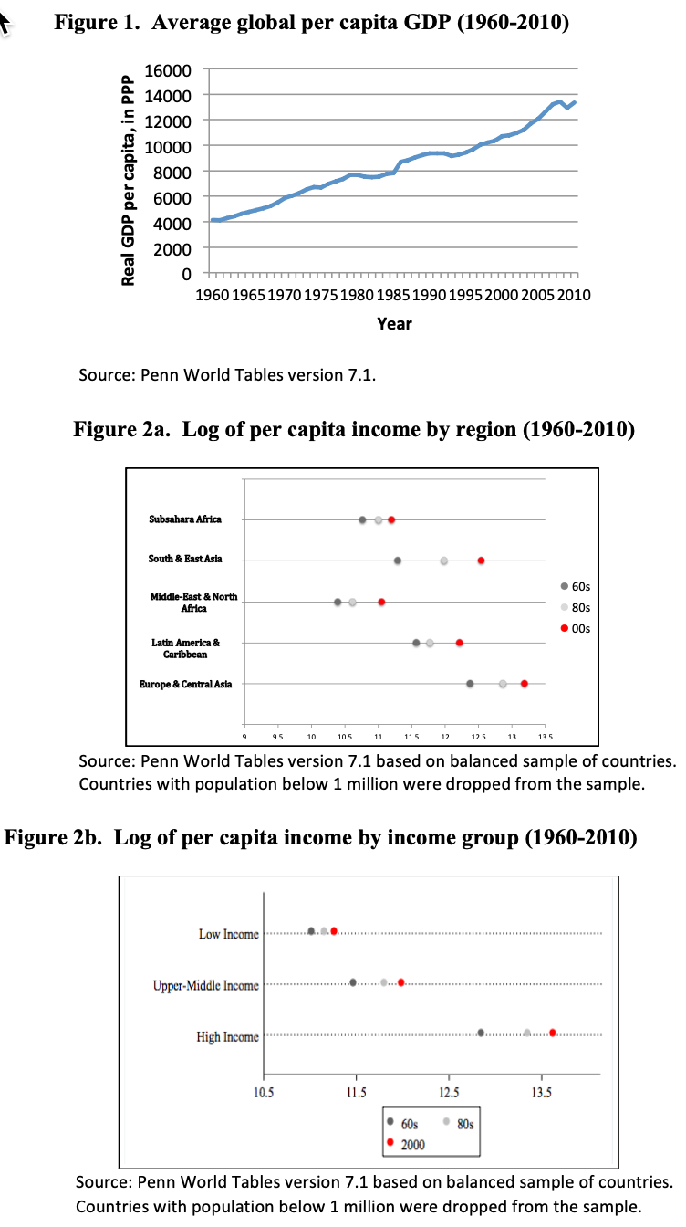
Individual Income Distribution
China & India are two very large countries:
China and Indian have done very well recently
Yet they are only two data points in the cross-country sample
Thus they have next to no influence on “convergence” regressions
Yet they are 40% of the human race
Question: is there any deeper logic to their sudden post-1980 ascent other than “they were lucky, and had good leaders”?

Slide 44
Catch Our Breath…
Ask a couple of questions?
Make a couple of comments?
Any more readings to recommend?

Slide 45
Dev Patel, Justin Sandefur, & Arvind Subramanian (2018): Everything You Know about Cross-Country Convergence Is (Now) Wrong
Questions:
What historical pattern about divergence/convergence on the global level since 1960 are PSS describing?
What do we think of the log specification here?
Can we map their changing estimated β coefficient to what we think we know about the economic history of the past 70 years?
Tell me again about why we should be interested in studies that take each country to be a single equal-weighted data point?
What do we think of Johnson and Papageorgiou’s reponse?
<https://www.piie.com/blogs/realtime-economic-issues-watch/everything-you-know-about-cross-country-convergence-now-wrong>

Slide 46
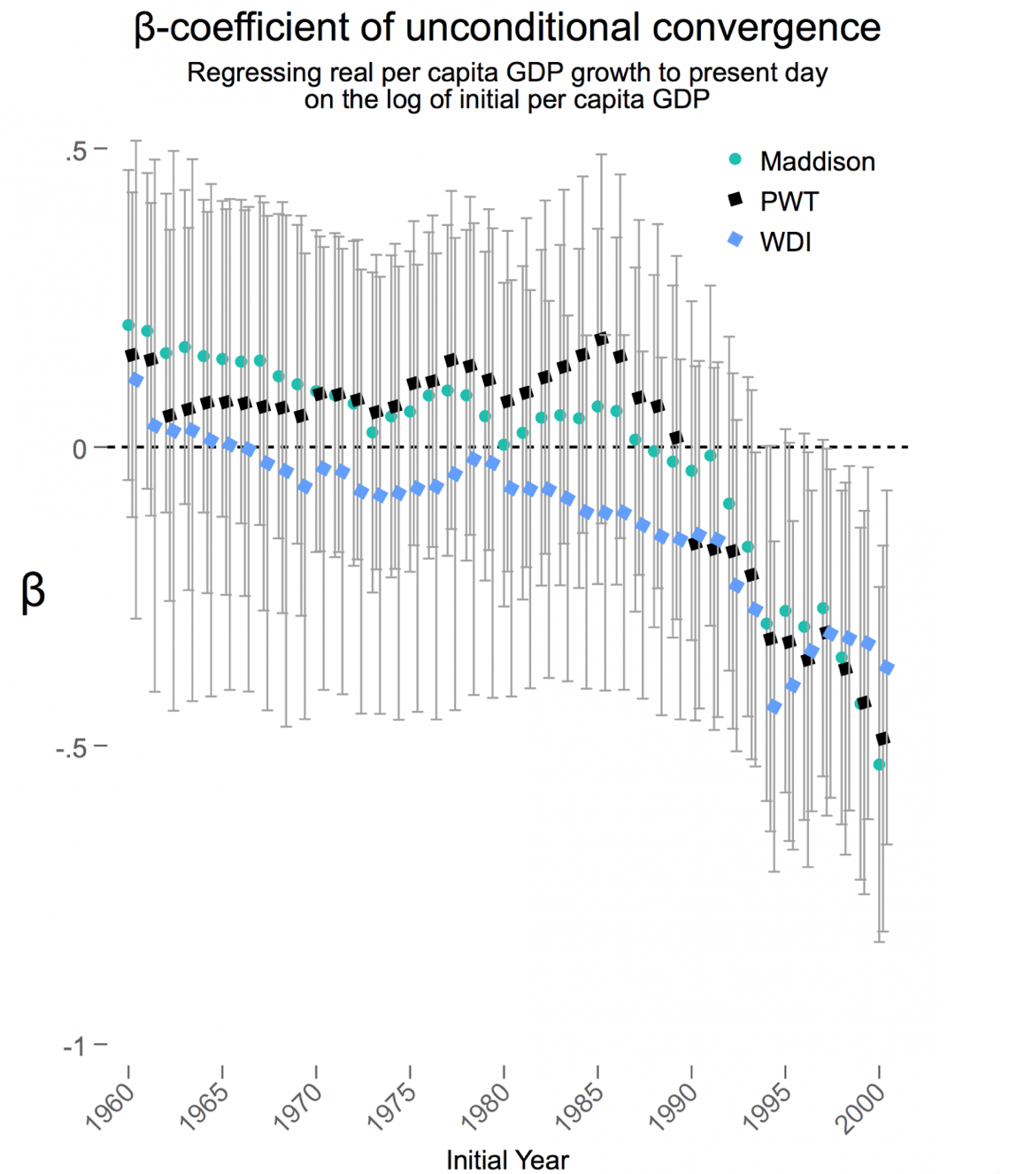
A Somewhat Strange Way of Presenting the Data…
PWT has been in this business longest:
WDI has made some significantly different choices than have others
Let’s stick to PWT:
Seems to say that world (with each country counting for one) about as unequal in 1985 as it was in 1960.
Then between 2000 and today half of the dependence on initial level has been removed
But between 1985 and 2000 initial conditions amplified themselves by 1.2
So in the PWT, 1960-1985, 1985-2000, 2000-2018 gives us:
x 1.0
x 1.2
x 0.5

Slide 47
Catch Our Breath…
Ask a couple of questions?
Make a couple of comments?
Any more readings to recommend?

Slide 48

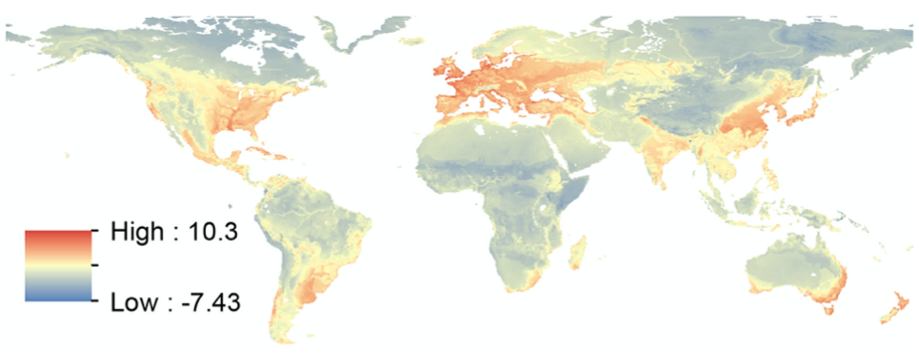
The “Deep Roots” Literature
Lights from outer space at night:
This reveals the global geographical distribution of human economic activity
Bottom is what is predicted from a regression of lights on geographical variables:
Base (ruggedness & malaria)
Soil & climate (suitability for agriculture)
Trade (ease of communication and transport by water)
“Geography” accounts for half of the global land variation in lights from space today
Vernon Henderson, Tim Squires, Adam Storeygard, and David Weil: The Global Distribution of Economic Activity: Nature, History, & the Role of Trade <https://github.com/braddelong/public-files/blob/master/readings/article-henderson-geography.pdf> <https://github.com/braddelong/public-files/blob/master/readings/article-henderson-geography-ii.pdf>

Slide 49
“Geography” Accounts for Half of Global Variation Today
Ruggedness & malaria, soil & climate, water access:
It has been a long time—500 years?—since humanity was tied in its location to where the most productive farms were
It has been a shorter but still substantial time—200 years—since humanity was bound in its location by the essential need for cheap water transport
Yet those factors are the “deep roots” of relative economic development, even though there is no geographical necessity today
And humanity’s geographical distribution of economic activity exhibits “path dependence”: the places where people settled and produced for reasons of trade and agriculture 500 and more years ago are still the places where people settle and produce.
Vernon Henderson, Tim Squires, Adam Storeygard, and David Weil: The Global Distribution of Economic Activity: Nature, History, & the Role of Trade <https://github.com/braddelong/public-files/blob/master/readings/article-henderson-geography.pdf> <https://github.com/braddelong/public-files/blob/master/readings/article-henderson-geography-ii.pdf>

Slide 50
What Does This Get Right? Wrong?
It gets a lot very right:
But it is not a perfect fit
Regions that are surprisingly prosperous?
Johannesburg & surroundings
India
The Persian Gulf
Northwest Europe/eastern USA
Coastal Brazil
Malaya and Java
Reasons that are not as prosperous as expected?
The lower Mississippi basin
The Boomerang Coast & New Zealand
Vernon Henderson, Tim Squires, Adam Storeygard, and David Weil: The Global Distribution of Economic Activity: Nature, History, & the Role of Trade <https://github.com/braddelong/public-files/blob/master/readings/article-henderson-geography.pdf> <https://github.com/braddelong/public-files/blob/master/readings/article-henderson-geography-ii.pdf>

Slide 51
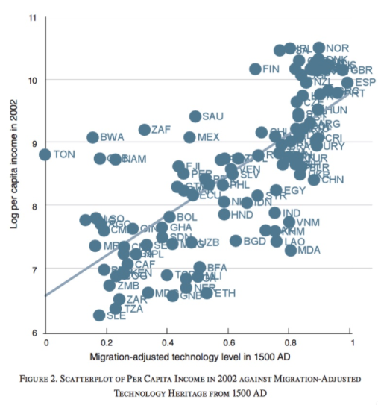
Technological Persistence
Take a look at what relative level of technological development economies were at in 1500:
Half of the relative technological level in 1500 is predicted by the relative technological level in -1000
When people move, they tend to carry their technologies with them
Across economies, half of the variation in log income per capita today is accounted for by the migration-adjusted level of technology back in 1500
Biggest outliers:
Vietnam, Laos, Cambodia, India—and Moldovia
Burkina Faso, Mali, Niger, Ethiopia, Guinea Bissau, Tanzania, Sierra Leone, and Madagascar
Tonga, Botswana, South Africa, Saudi Arabia, and Mexico
Most influential observations:
the global north in the upper right, and much of sub-Saharan tropical Africa in the lower left
Diego Comin, William Easterly, and Erick Gong: Was the Wealth of Nations Determined in 1000 BC? <https://github.com/braddelong/public-files/blob/master/readings/article-comin-wealth-of-nations.pdf>

Slide 52
Catch Our Breath…
Ask a couple of questions?
Make a couple of comments?
Any more readings to recommend?

Slide 53
Growth Speedups & Slowdowns
Brad DeLong
U.C. Berkeley
Last Edited: 2020-04-13

Slide 54
Readings
Growth Speedups & Slowdowns:
Nicholas Crafts (2002): The Solow Productivity Paradox in Historical Perspective <http://www.cepr.org/pubs/dps/DP3142.asp>
Dani Rodrik (1995): Getting Interventions Right: How South Korea and Taiwan Grew Rich <http://tinyurl.com/dl20090112t>
Peter J. Klenow & Andres Rodriguez-Clare (1997): The Neoclassical Revival in Growth Economics: Has It Gone too Far? <https://delong.typepad.com/klenow-rodriguez-clare.pdf>

Slide 55
For May 6 Class: Readings
The Great Compression:
Claudia Goldin & Robert Margo (1992): The Great Compression: The U.S. Wage Structure at Midcentury <https://academic.oup.com/qje/article/107/1/1/1925779>
Claudia Goldin (2001): The Human-Capital Century and American Leadership: Virtues of the Past <http://www.nber.org/papers/w8239>
Growth Speedups & Slowdowns:
Nicholas Crafts (2002): The Solow Productivity Paradox in Historical Perspective <http://www.cepr.org/pubs/dps/DP3142.asp>
Dani Rodrik (1995): Getting Interventions Right: How South Korea and Taiwan Grew Rich <http://tinyurl.com/dl20090112t>
Peter J. Klenow & Andres Rodriguez-Clare (1997): The Neoclassical Revival in Growth Economics: Has It Gone too Far? <https://delong.typepad.com/klenow-rodriguez-clare.pdf>
American Exceptionalism:
Kenneth Sokoloff (1984): Was the Transition from the Artisanal Shop to the Non-Mechanized Factory Associated with Gains in Efficiency? <http://www.nber.org/papers/w1386>
Daniel Gross (2017): Scale versus Scope in the Diffusion of New Technology: Evidence from the Tractor <https://www.nber.org/papers/w24125>
Dave Donaldson & Richard Hornbeck (2016): Railroads and American Economic Growth: A ‘Market Access’ Approach <https://academic.oup.com/qje/article/131/2/799/2606976>

Slide 56
Econ 210a
May 6, 2020 Class
Brad DeLong
U.C. Berkeley
Last Edited: 2020-04-29

Slide 57
Readings
The Great Compression:
Claudia Goldin & Robert Margo (1992): The Great Compression: The U.S. Wage Structure at Midcentury <https://academic.oup.com/qje/article/107/1/1/1925779>
Claudia Goldin (2001): The Human-Capital Century and American Leadership: Virtues of the Past <http://www.nber.org/papers/w8239>
American Exceptionalism:
Kenneth Sokoloff (1984): Was the Transition from the Artisanal Shop to the Non-Mechanized Factory Associated with Gains in Efficiency? <http://www.nber.org/papers/w1386>
Daniel Gross (2017): Scale versus Scope in the Diffusion of New Technology: Evidence from the Tractor <https://www.nber.org/papers/w24125>
Dave Donaldson & Richard Hornbeck (2016): Railroads and American Economic Growth: A ‘Market Access’ Approach <https://academic.oup.com/qje/article/131/2/799/2606976>

Slide 58
Paper Presentations
????:

Slide 59
Catch Our Breath…
Ask a couple of questions?
Make a couple of comments?
Any more readings to recommend?

Slide 60

Coronavirus!

Slide 61
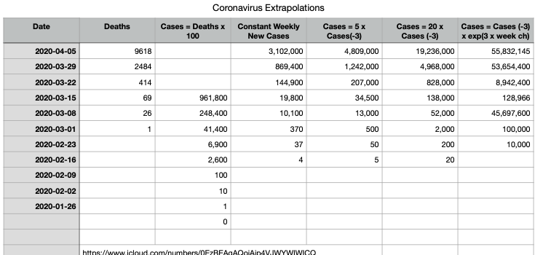
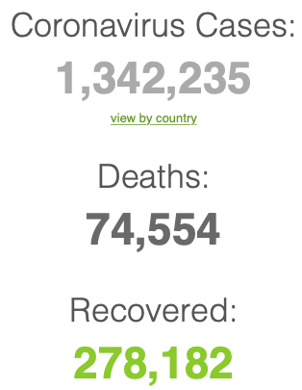
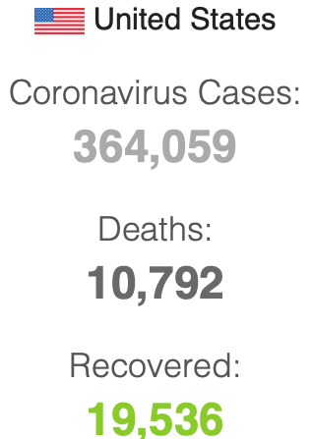

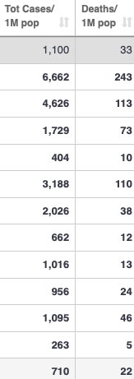
Coronavirus
Where we think we are, as of Mo Apr 6:
We really do not know
No random samples…
If we extrapolate out the past week straight-line log:
We will have 440,000 deaths in three weeks
But it is unlikely to be that bad
Best thing I have read comes from Jim Stock <https://drive.google.com/file/d/12MV466ZZy5xHir4xdPhoTrL1oO8CbZU-/view>:
The basic SIR epidemiological model of contagion
The effect of social distancing and business shutdowns on epidemic dynamics enters the model through a single parameter: the case transmission rate β
Re-express the model in terms of β and the asymptomatic (or not very symptomatic) hence non-tested rate—the fraction of the infected who are not tested
The COVID-19 non-testing rate is unidentified in our model
Estimates in the epidemiological literature range from 0.18 to 0.86.
The asymptomatic rate could be estimated accurately and quickly by testing a random sample
The optimal policy response and its economic consequences hinge critically on the asymptomatic rate

Slide 62
Coronavirus II
We do not really know where we are, as of Mo Apr 6:
Best thing I have read comes from Jim Stock <https://drive.google.com/file/d/12MV466ZZy5xHir4xdPhoTrL1oO8CbZU-/view>:
The basic SIR epidemiological model of contagion
The effect of social distancing and business shutdowns on epidemic dynamics enters the model through a single parameter: the case transmission rate β
Re-express the model in terms of β and the asymptomatic (or not very symptomatic) hence non-tested rate—the fraction of the infected who are not tested
The COVID-19 non-testing rate is unidentified in our model
Estimates in the epidemiological literature range from 0.18 to 0.86.
The asymptomatic rate could be estimated accurately and quickly by testing a random sample
The optimal policy response and its economic consequences hinge critically on the asymptomatic rate

Slide 66

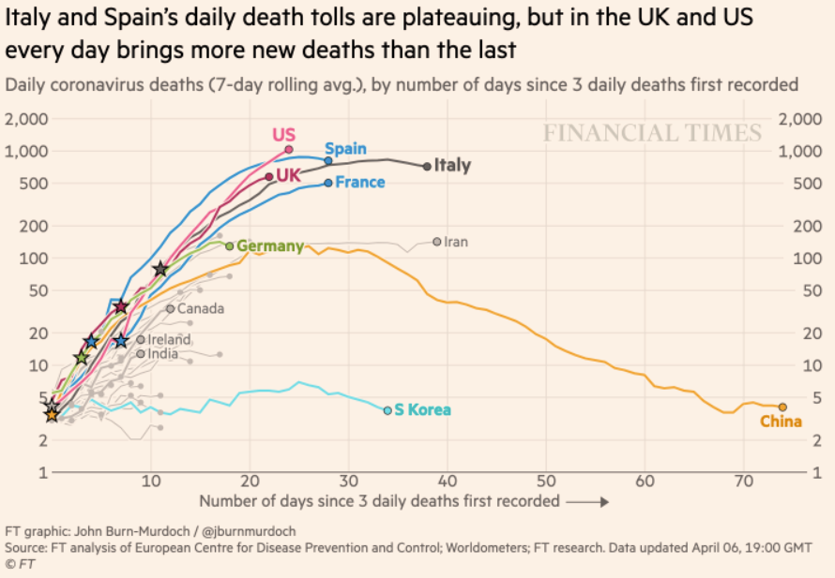
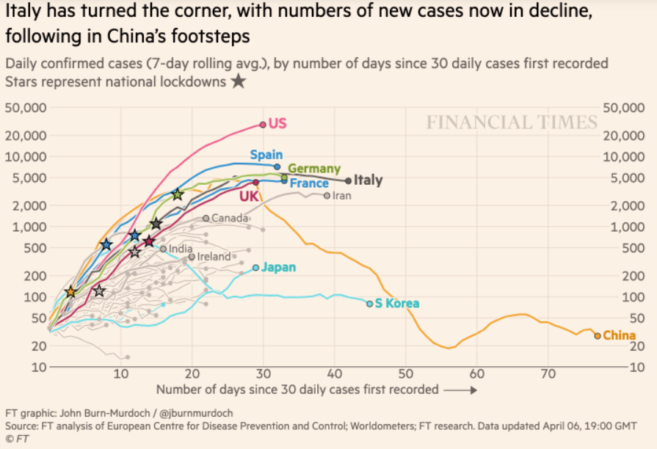
Financial Times Graphs Blown Up…

Slide 70
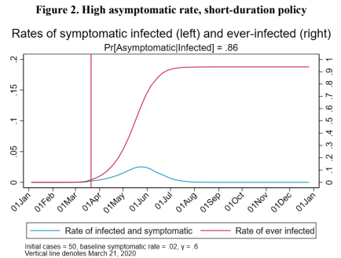
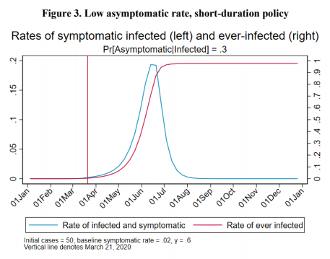
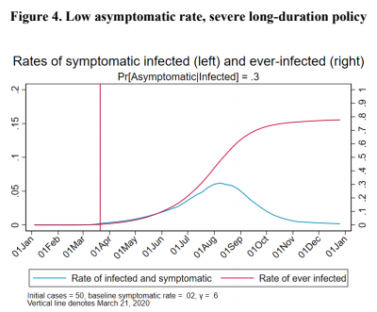
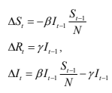
James Stock (2020)
Standard SIR model:<https://drive.google.com/file/d/12MV466ZZy5xHir4xdPhoTrL1oO8CbZU-/view>:
Susceptible, Infected, Recovered (& immune), transmission rate β, recovery rate γ, reproduction number R0, asymptomatic hence non-tested rate π0
Calibration: half-life of infection one week: γ = 0.5, s0 = 0.02, 50 cases on Jan 24
For March 21, 2020, the positive test rate in the United States is approximately 10%…
<https://drive.google.com/file/d/12MV466ZZy5xHir4xdPhoTrL1oO8CbZU-/view>

Slide 75
Bringing the Economy Back Up from Anæsthesia
Major issues:
Certificates of immunity:
Which requires test, test, test:
And not just disease virus tests
Presence-of-antibodies tests
How quickly can we match the immune with public-contact jobs?
What jobs can be done with minimal infection risk?
What minimal-infection substitutes can we find for previous jobs?
How quickly can restrictions be relaxed without the virus coming roaring back?
How do we avoid having the market give a “shutdown” signal to enterprises we in fact want restarted?
Which is pretty much all of them
How much of the potential caseload do we want to push out beyond the vaccine-arrival date?
ALL THESE QUESTIONS ARE ANSWERABLE IF WE LEARN THE ASYMPTOMATIC HENCE NON-TESTED RATE!!

Slide 76
Keeping the Economy from Crashing During the Lockdown
Nick Rowe: We have a 50% output cut in 100% of the sectors:
A temporary 100% output cut in 50% of the sectors (what the Coronavirus does) is very different from a 50% output cut in 100% of the sectors
Nick’s thought experiment:
In three months we are going to invent unobtanium:
Substantial intertemporal substitutibility
Plus lower cross-good contemporaneous substitutitbility
Hence high desired savings rate now
Flex-price market thus produces a nominal rate at the zero lower bound and a high inflation rate over the next three to six months
Plus liquidity-constrained workers in affected sectors see their demand go to zero immediately
Can we get there? Should we get there? What should we do instead?
We need a good RBC economist: are there any?…
<https://worthwhile.typepad.com/worthwhile_canadian_initi/2020/03/relative-supply-shocks-unobtainium-walras-law-and-the-coronavirus.html>

Slide 77
Keeping the Economy from Crashing During the Lockdown II
Nick Rowe:
<https://worthwhile.typepad.com/worthwhile_canadian_initi/2020/03/relative-supply-shocks-unobtainium-walras-law-and-the-coronavirus.html>
Plus: to extend the thought experiment:
We just lost the ability to make “unobtainium”
So we should be substituting leisure for work, and moving workers into relatively unproductive labor, making the commodities we can still produce right now
How should relative prices move as a result? How should we make them move?
Plus: distributional issues
Plus: bankruptcy and credit chain issues

Slide 78

MOAR Coronavirus!
Death for Geezers!
Mortality for the Youngs very low…
It’s the flu for them—for you…
And an extra doubling—or is it 5%?—mortality for the asthmatic
And an extra doubling—or is it 5%?—mortality for the overweight

Slide 79
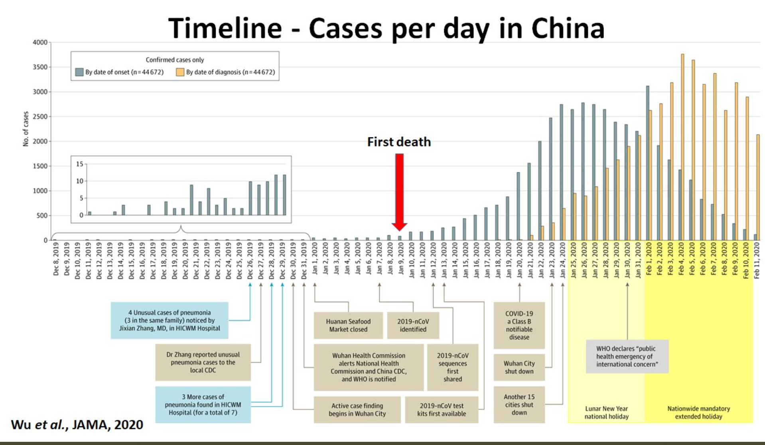
What We Think Happened in Wuhan
China beat it quickly & relatively easily!
We think
Shut down Wuhan when 200 cases per day
That seems to have been a good decision

Slide 80

The Goal
When Is It Appropriate to Move on This?
Immediate social distancing…
Self-isolate if you have a cough and a fever…
Hope that warmer temperatures will do to this what they did to SARS…
Otherwise, when do you want to start spreading out transmission. It seems that early is as good as later, so do it early…
I have no good intuition on why you want to move early
Plus your moving early will be wasted if you get reinfected
Plus the sparks you throw off making others’ lives more difficult

Slide 81
References
Financial Times (2020): Coronavirus Tracked: The Latest Figures as the Pandemic Spreads <https://www.ft.com/coronavirus-latest>
Nick Rowe (2020): Relative Supply Shocks, Unobtainium, Walras' Law, and the Coronavirus <https://worthwhile.typepad.com/worthwhile_canadian_initi/2020/03/relative-supply-shocks-unobtainium-walras-law-and-the-coronavirus.html>
Jim Stock (2020): Coronavirus Data Gaps and the Policy Response <https://drive.google.com/file/d/12MV466ZZy5xHir4xdPhoTrL1oO8CbZU-/view>

Slide 82
MOAR Coronavirus!
What I am watching:
Max Roser & Hannah Ritchie: Coronavirus Disease (COVID-19) <https://ourworldindata.org/coronavirus>…
Worldometer: Coronavirus Update (Live) <https://www.worldometers.info/coronavirus/>: ‘125,599 Cases and 4,605 Deaths from COVID-19 Virus Outbreak…
FT Coronavirus Tracker <https://www.ft.com/content/a26fbf7e-48f8-11ea-aeb3-955839e06441>
Josh Marshall’s COVID Twitter List <https://twitter.com/i/lists/1233998285779632128>
NEJM Group: Updates on the Covid-19 Pandemic <http://m.n.nejm.org/nl/jsp/m.jsp?c=%40kxNtXckRDOq8oG0jJvAXsIzN4mPECIPhltxoTSdTU9k%3D&cid=DM89089_NEJM_COVID-19_Newsletter&bid=173498255>: 'From the New England Journal of Medicine, NEJM Journal Watch, NEJM Catalyst, and other trusted sources...

Slide 83
Catch Our Breath…
Ask a couple of questions?
Make a couple of comments?
Any more readings to recommend?
<https://www.icloud.com/keynote/0YKEi7HeOrVGvKYtt9FEqH7nA>
<https://www.bradford-delong.com/2020/04/coronavirus.html>
github:<https://github.com/braddelong/public-files/blob/master/coronavirus.pptx>
https://github.com/braddelong/public-files/blob/master/coronavirus.pdf>
html File: <https://www.bradford-delong.com/2020/04/coronavirus.html>
Edit This File: <https://www.typepad.com/site/blogs/6a00e551f08003883400e551f080068834/post/6a00e551f080038834025d9b3bd66a200c/edit>
<https://delong.typepad.com/files/2020-04-01-coronavirus.pdf>

Slide 84
Coronavirus! (March 16)
With 31 deaths in the U.S. as of March 11, a 1% death rate, and up to 4 weeks between infection and death, that means that as of Feb 12 there were 3100 coronavirus cases in the United States.
With 87 deaths in the U.S. as of Mar 16, a 1% death rate, and up to 4 weeks between infection and death, that means that as of Feb 17 there were 8700 coronavirus cases in the United States
If it is doubling every seven days, then now about 150,000 people have and in the next week about 150,000 more people in the U.S. will catch coronavirus—which means 1/2200, currently 3500 of the 7.6 million inhabitants of San Francisco Bay. Touch a hard surface that any of those 3500 has touched in the last 48 hours, and the virus has a chance to jump to you…
These numbers could be five times too big. These numbers are probably not five times too small unless the thing is a lot less deadly, and there are a lot of asymptomatic cases…
What is wrong with this analysis?

Slide 85

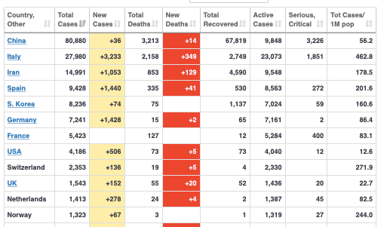
MOAR Coronavirus!
As of March 21: Things are not moving in the right direction:
What is the R0?
How can the R0 be changed?
How will the R0 change?
What is the asymptote share of the population?
What is the mortality rate?

Slide 86
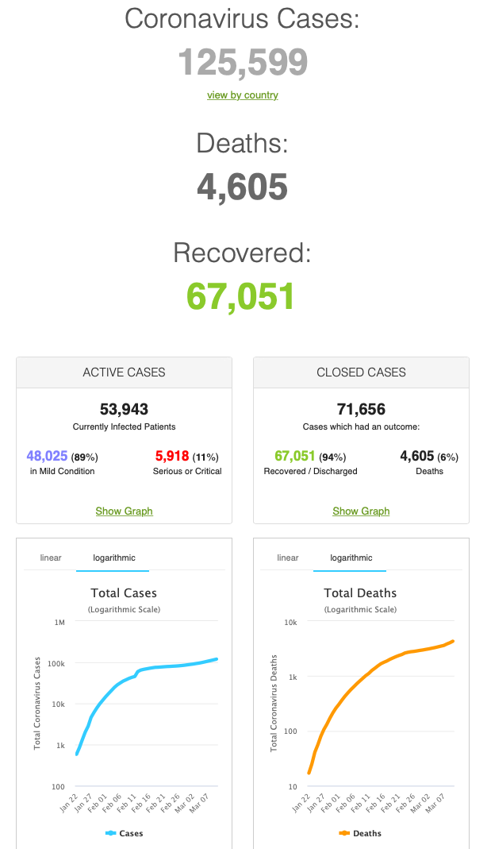
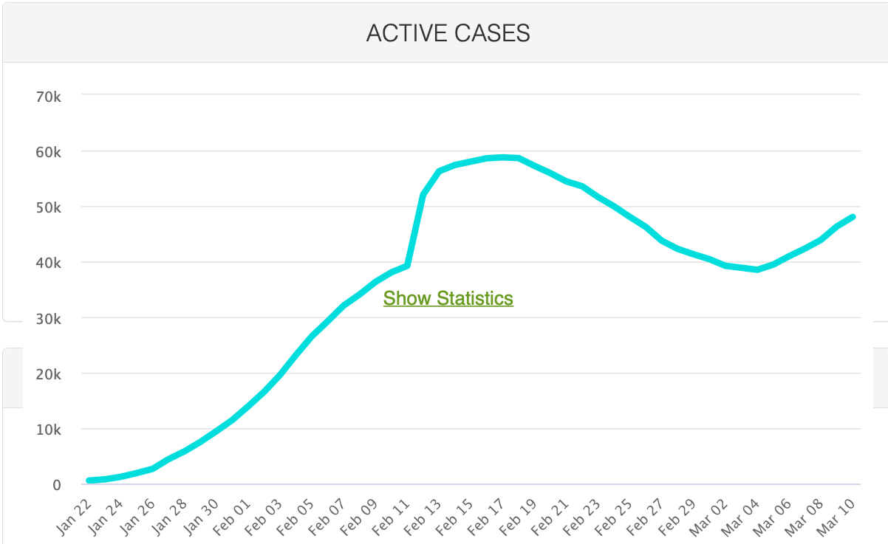
MOAR Coronavirus!
As of March 10: Things are not moving in the right direction:
What is the R0?
How can the R0 be changed?
How will the R0 change?
What is the asymptote share of the population?
What is the mortality rate?

Slide 87
Notes

Slide 88
Econ 210a
Other Classes…
Brad DeLong
U.C. Berkeley
Last Edited: 2020-04-29

Slide 89
Readings
Inequality:
Branko Milanovic, Peter H. Lindert, & Jeffrey G. Williamson (2010): Pre-Industrial Inequality <http://onlinelibrary.wiley.com/doi/10.1111/j.1468-0297.2010.02403.x/abstract>
Thomas Piketty & Gabriel Zucman (2014): Capital Is Back: Wealth-Income Ratios in Rich Countries 1700–2010 <http://qje.oxfordjournals.org/content/129/3/1255.full.pdf>
Unfreedom:
Nathan Nunn (2008): The Long-Term Effects of Africa’s Slave Trades <http://www.jstor.org/stable/pdfplus/25098896.pdf>
Women, Men, & Children:
Abigail Smith Adams (1776): Letter to John Adams 31 March - 5 April 1776 <https://www.masshist.org/digitaladams/archive/doc?id=L17760331aa>
Martha Bailey (2013): Fifty Years of Family Planning: New Evidence on the Long-Run Effects of Increasing Access to Contraception <http://www.nber.org/papers/w19493>
Claudia Goldin (1991): The Rise of Women’s Employment <http://www.journals.uchicago.edu/doi/abs/10.1086/649603>
Heather Antecol, Kelly Bedard, & Jenna Stearns (2018): Equal but Inequitable: Who Benefits from Gender-Neutral Tenure Clock Stopping Policies <https://pubs.aeaweb.org/doi/pdf/10.1257/aer.20160613>
Alberto Alesina, Paola Giuliano, & Nathan Nunn (2013), On the Origins of Gender Roles: Women and the Plough <https://scholar.harvard.edu/files/nunn/files/alesina_giuliano_nunn_qje_2013.pdf>

